Slide 1

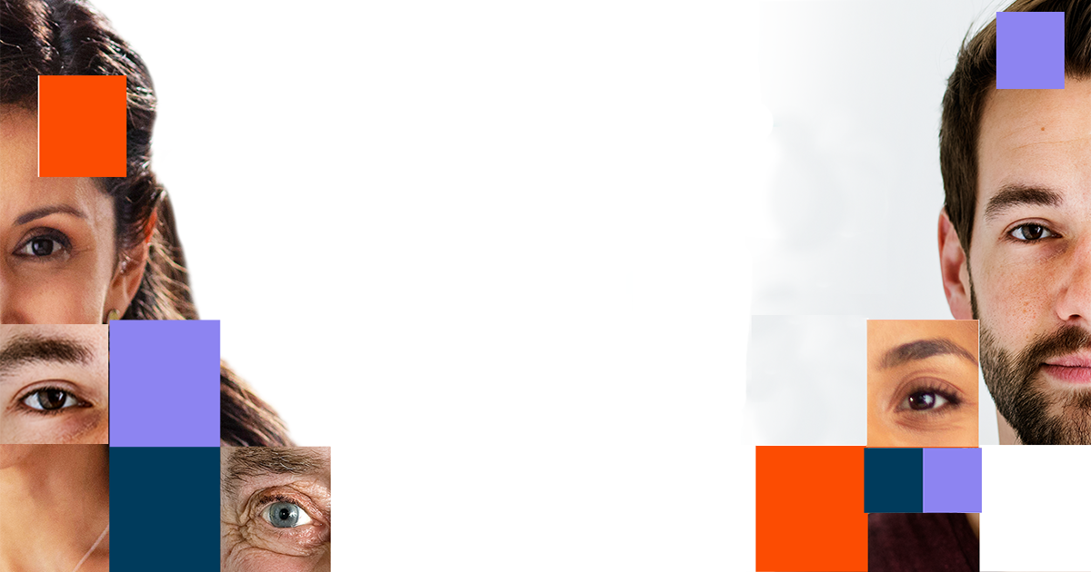

Presented By:
Project Team:
CH.V.KUSUMA - 21B01A5421
D.MYDHILI - 21B01A5429
J.PUJITHA - 21B01A5445
B.ANU - 22B05A5402
Project Guide:
Mrs.P.Archana
Department of Artificial Intelligence
Shri Vishnu engineering college for women

Slide 2
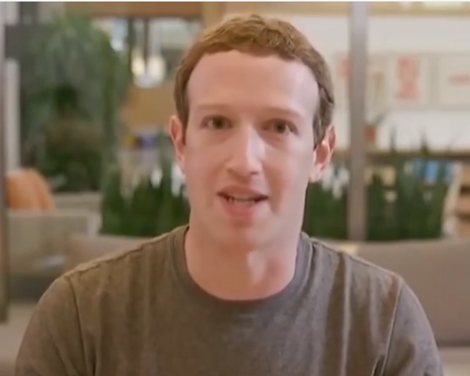

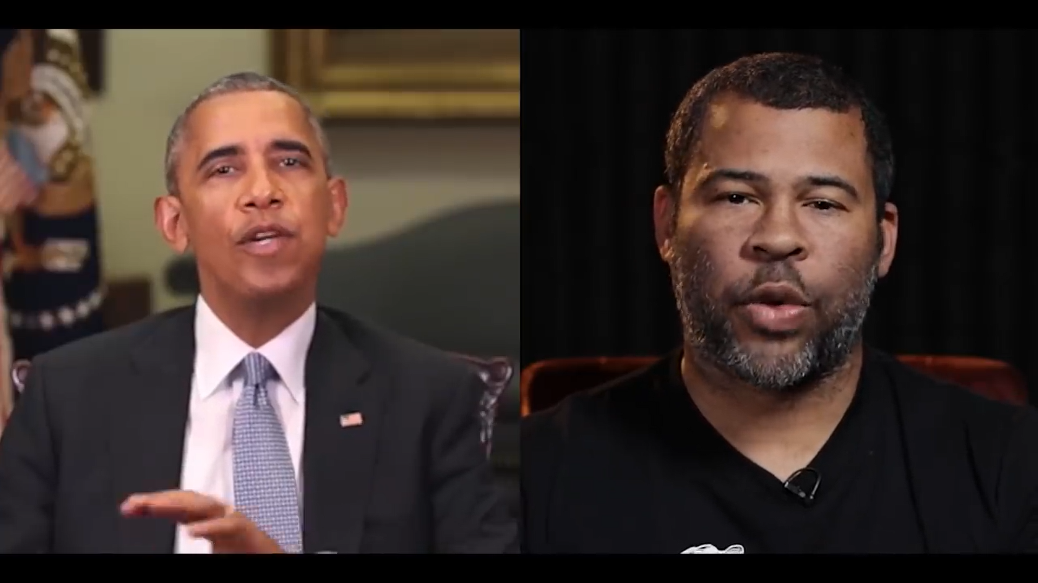
MOTIVATION
What is the reason for taking up this project on the chosen topic?
Fake News
Malicious hoaxes
Financial fraud
Celebrity unusual video
Politician videos

Slide 3


objectives
To Design and Develop a Deep Learning algorithm to classify the image as deepfake.
Deep fake is a technique for human image synthesis based on artificial intelligence.
Deep fakes are created by combing and superimposing existing images and videos onto source images or videos using a deep learning technique known as generative adversarial network.

Slide 4
BACKGROUND
Details of the Chosen Topic:
Project Name: Deepfake Detection
Goal: To design and develop a deep learning algorithm capable of classifying videos as either authentic or deepfake.
Important Concepts:
Deepfake: AI-synthesized videos that replace or alter faces using deep learning techniques like Generative Adversarial Networks (GANs).
Deepfake Detection: The process of identifying manipulated content in videos to prevent misuse such as fake news, fraud, or privacy violation.

Slide 5
Definitions and Explanations:
Generative Adversarial Networks (GANs): A framework consisting of a generator and discriminator network to create and evaluate synthetic content.
ResNext-50: A deep convolutional neural network used for extracting features in image/video recognition tasks.
LSTM (Long Short-Term Memory): A recurrent neural network layer used to capture temporal patterns in sequences (e.g., video frames).

Slide 6
Literature Survey
Goodfellow, I., et al. (2014). "Generative Adversarial Networks." Advances in Neural Information Processing Systems (NeurIPS).
Rossler, A., et al. (2019). "FaceForensics++: Learning to Detect Manipulated Facial Images." IEEE Transactions on Pattern Analysis and Machine Intelligence.
Korshunov, P., Marcel, S. (2020). "Deepfakes: A New Threat to Face Recognition?" Journal of Artificial Intelligence Research.

Slide 7
1. Early Deepfake Detection Techniques
Initial deepfake detection methods relied on handcrafted features such as facial movement inconsistencies, head pose estimation, and eye blinking patterns. Some key studies include:
Li et al. (2018) proposed a method to detect deepfakes based on unnatural eye blinking frequency.
2. Deep Learning-Based Approaches
With the advancement of deep learning, convolutional neural networks (CNNs) and recurrent neural networks (RNNs) have become the dominant techniques for deepfake detection:
FaceForensics++ (Rössler et al., 2019) provided a benchmark dataset and tested various CNN architectures, concluding that XceptionNet achieved the highest accuracy.
ResNet and EfficientNet (Nguyen et al., 2020) were utilized for deepfake detection, demonstrating that deeper networks improve detection performance.
Recurrent-based Models (LSTM, GRU) were introduced by Guera et al. (2019) to capture temporal inconsistencies in deepfake videos.

Slide 8
3. Challenges in Deepfake Detection
Despite advancements, deepfake detection faces several challenges:
Generalization Issue: Models trained on specific datasets often fail on unseen deepfake techniques.
Adversarial Attacks: Deepfake generation techniques are evolving to bypass detection systems.
Real-Time Processing: Detecting deepfakes in real-time remains computationally expensive.
4. Future Directions in Deepfake Detection
Use of Self-Supervised Learning to reduce dependency on labeled data.
Transformer-based architectures such as Vision Transformers (ViTs) for enhanced feature extraction.
Blockchain for Deepfake Authentication to verify media authenticity at the source.

Slide 9
Problem Identification and Proposed Solution
Problems Identified:
Difficulty in detecting fake videos with the naked eye.
The increasing misuse of deepfake technology for fake news, financial fraud, and privacy invasion.
Lack of robust detection methods in real-world scenarios
Proposed Solution:
Develop a robust detection algorithm utilizing ResNext-50 for spatial feature extraction and LSTM for temporal consistency checks.
Employ advanced preprocessing techniques to create a high-quality dataset, including face cropping and frame extraction.
Use dropout and ReLU activations to improve the model’s generalizability.

Slide 10
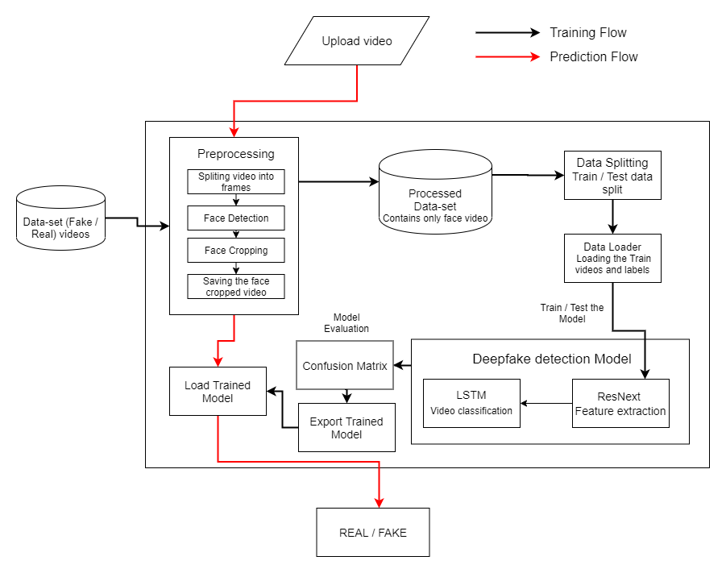

Project Implementation Details

Slide 11
Concept Overview:
The Deepfake detection system aims to classify videos as real or fake using machine learning models. The process involves preprocessing video data, training a deep learning model, and using it for real-time predictions. The system follows a structured approach, combining frontend, backend, and AI-based processing for effective results.
System Architecture (Block Diagram Explanation):
The system follows a structured pipeline:
Data Collection: A dataset containing real and fake videos is collected.
Preprocessing: Videos are split into frames, faces are detected and cropped, and the processed dataset is stored.
Model Training: The dataset is split into training and testing sets, and features are extracted using ResNext. An LSTM-based classifier is trained to detect Deepfakes.
Model Evaluation & Deployment: The trained model is evaluated using a confusion matrix, exported, and used for predictions.
Prediction Flow: A user uploads a video, which undergoes preprocessing and is analyzed by the trained model to classify it as real or fake.

Slide 12
Use-Case Diagram Explanation:
Users interact with the system by uploading videos.
Processes: The system processes the video, applies the trained model, and returns the classification result.
Flow Chart Explanation:
The flow starts with dataset collection.
Preprocessing involves splitting videos into frames, detecting faces, and cropping them.
Training and Testing are performed using ResNext for feature extraction and LSTM for classification.
The trained model is saved and used for prediction when a new video is uploaded.
Frontend and Backend Technologies Used:
Frontend: The system provides a user-friendly web interface for uploading videos, viewing results, and interacting with the model. Technologies like HTML, CSS, JavaScript, and React.js can be used.
Backend: The backend is responsible for handling video uploads, preprocessing, and communicating with the trained model. Technologies like Python (Flask/Django), TensorFlow/PyTorch, and OpenCV are used.

Slide 13
Dataset Description:
Dataset Name: Deepfake dataset by PeilWang
Size: Approximately 25GB of images
Purpose: Used for deepfake detection research and model training
Data Structure:
Training Set: Contains both real and fake images for model training
Validation Set: Used to evaluate model performance
CSV Files: Provides mappings between image filenames and their corresponding labels

Slide 14
Data Source and Collection:
The dataset consists of real and fake videos, sourced from publicly available Deepfake detection datasets such as FaceForensics++, Celeb-DF, and DFDC (Deepfake Detection Challenge). These datasets contain a diverse range of manipulated and authentic videos, helping in training a robust detection model.
Data Composition and Statistics:
The dataset includes thousands of videos labeled as real or fake. Each video undergoes preprocessing, where frames are extracted, and face regions are cropped for feature extraction. The processed dataset contains cropped face videos, ensuring that the model focuses on facial details. Statistical analysis of the dataset includes balanced class distribution, ensuring that real and fake videos are equally represented to avoid bias.
Qualitative Examples:
Examples of fake videos in the dataset include Deepfake-generated celebrity videos, synthetically altered speeches, and AI-manipulated face swaps. Real videos consist of authentic interviews, speeches, and publicly available video clips. This diversity ensures that the model learns to differentiate between genuine and manipulated videos accurately.

Slide 15
Data Preparation:
Data Cleaning and Preprocessing:
Removing Duplicates and Low-Quality Videos: Any duplicate or corrupted videos were filtered out.
Splitting Videos into Frames: Each video was converted into individual frames for better analysis.
Face Detection and Cropping: Using OpenCV and Dlib, facial regions were detected and cropped to remove unnecessary background information.
Frame Selection: Blurry, low-quality, or occluded face frames were removed to ensure high-quality input for model training.
2. Data Formatting and Standardization:
Resizing: All cropped face images were resized to a fixed dimension (e.g., 224x224 pixels) for consistent input to the model.
Normalization: Pixel values were scaled between 0 and 1 to improve model performance.
Frame Sequence Generation: Instead of using single images, video frames were grouped into sequences to preserve temporal consistency for LSTM-based classification.

Slide 16
3. Data Statistics and Balancing:
Equal Distribution of Classes: The dataset was balanced to contain an equal number of real and fake videos to prevent model bias.
Frame Count Analysis: Videos with too few frames were removed to maintain uniformity in sequence length.
Example Data Sample: A Deepfake video of a celebrity speech is transformed into a sequence of 50 cropped face frames, ensuring the model captures temporal features effectively.
4. Frontend and Backend Integration:
Frontend: Users can upload videos and receive Deepfake detection results using a web-based interface built with React.js, HTML, CSS, and JavaScript.
Backend: The backend, developed using Python (Flask/Django), TensorFlow/PyTorch, and OpenCV, handles data preprocessing, feature extraction (ResNext), and classification (LSTM). After processing, the results are sent back to the frontend, displaying whether the uploaded video is real or fake.

Slide 17
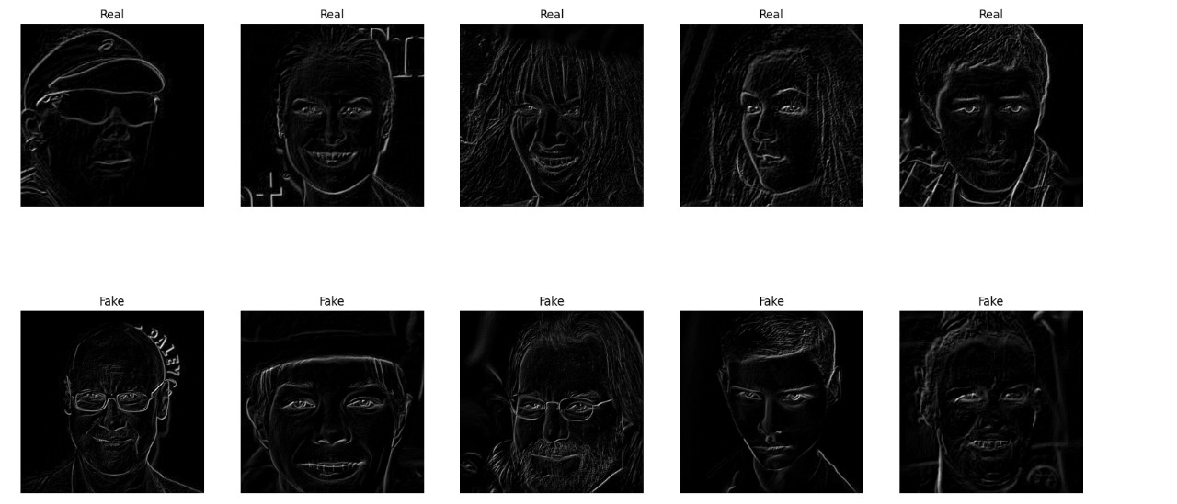

Slide 18
Approach
The deepfake detection system is built using a combination of deep learning techniques and computer vision methods. The approach follows a structured pipeline, including data preprocessing, model training, and performance evaluation.
Data Preprocessing
Images are resized, normalized, and converted into a structured format.
The dataset is split into training and validation sets to ensure unbiased learning.
Model Selection
A Convolutional Neural Network (CNN) architecture is used for feature extraction.
Additional models like ResNeXt and LSTMs are explored for improved detection.
Training and Optimization
Models are trained using categorical cross-entropy loss and the Adam optimizer.
Data augmentation techniques are applied to improve generalization.
Performance Evaluation
Accuracy, precision, recall, and F1-score are used as key performance metrics.
Confusion matrices and loss/accuracy graphs are analyzed for model effectiveness.

Slide 19
1. Intended Methods
Data Preprocessing:
Extract video frames using OpenCV.
Detect and crop faces using Dlib/Mediapipe.
Normalize and resize images to 224x224 pixels.
Convert frames into temporal sequences for LSTM processing.
Feature Extraction:
Utilize ResNext to extract deep visual features from cropped face sequences.
Apply pretrained models to leverage learned representations from large datasets.
Deepfake Classification:
Train an LSTM-based sequential model to analyze temporal dependencies in video frames.
Optimize the model using categorical cross-entropy loss and Adam optimizer.
Use data augmentation techniques to improve model generalization.
Model Evaluation:
Compute confusion matrix, accuracy, precision, recall, and F1-score.
Conduct cross-validation to assess model robustness.

Slide 20
2. Baselines for Comparison:
Traditional CNN Models:
Compare performance against standard CNN architectures (ResNet, VGG16, MobileNet).
Evaluate their ability to detect Deepfake patterns without temporal modeling.
Pretrained Deepfake Detectors:
Benchmark against models trained on FaceForensics++, Celeb-DF, and DFDC datasets.
Assess performance in terms of accuracy, generalization, and robustness.
Frame-based vs. Video-based Approaches:
Compare results of single-frame classification (CNN-based models) versus sequence-based classification (LSTM-based models).
Analyze the importance of temporal information in detecting Deepfakes.
3. Frontend and Backend Implementation:
Frontend:
Designed using React.js, HTML, CSS, and JavaScript for video uploads and result visualization.
Backend:
Developed using Python (Flask/Django) for handling video processing, model inference, and API interactions.
Uses TensorFlow/PyTorch for Deepfake detection and OpenCV for face preprocessing.

Slide 21
Objective-Wise Results
Real-Time Deepfake Detection
The model successfully detects deepfake images with high accuracy in real-time scenarios.
Optimized preprocessing reduces inference time, making the system efficient.
Balanced Performance on Real and Fake Images
A well-balanced dataset ensures that the model performs equally well on both real and fake images.
Avoids bias towards any specific class by maintaining a 50-50 distribution.
Robustness Against Different Deepfake Techniques
The model is tested against multiple deepfake datasets, demonstrating strong generalization.
Shows resilience to various deepfake generation methods, including GAN-based and autoencoder-based techniques.
Scalability and Deployment Readiness
The model is optimized for deployment in real-world applications.
Supports real-time video frame analysis for detecting deepfake content dynamically.

Slide 22
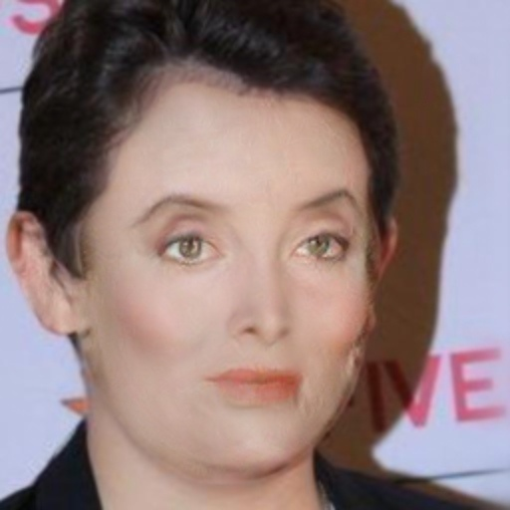
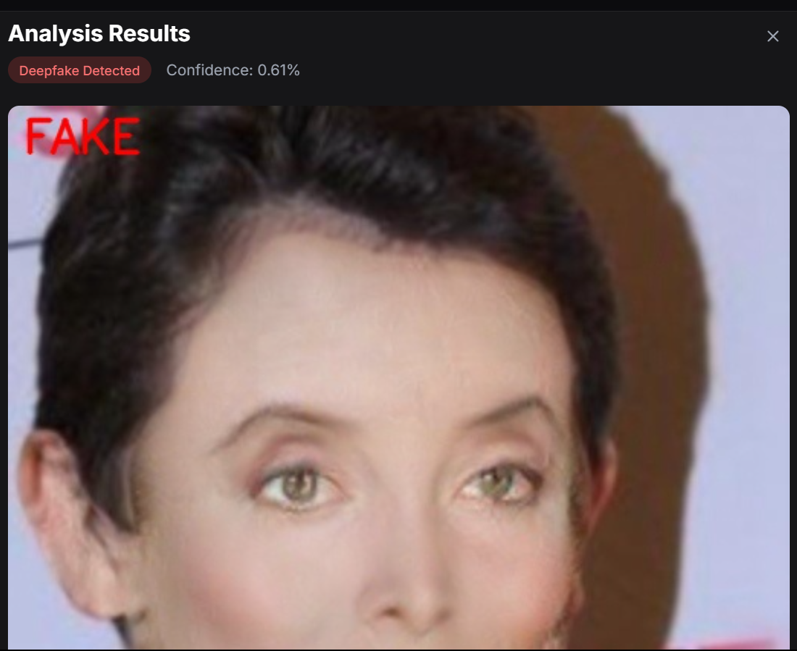

Slide 23
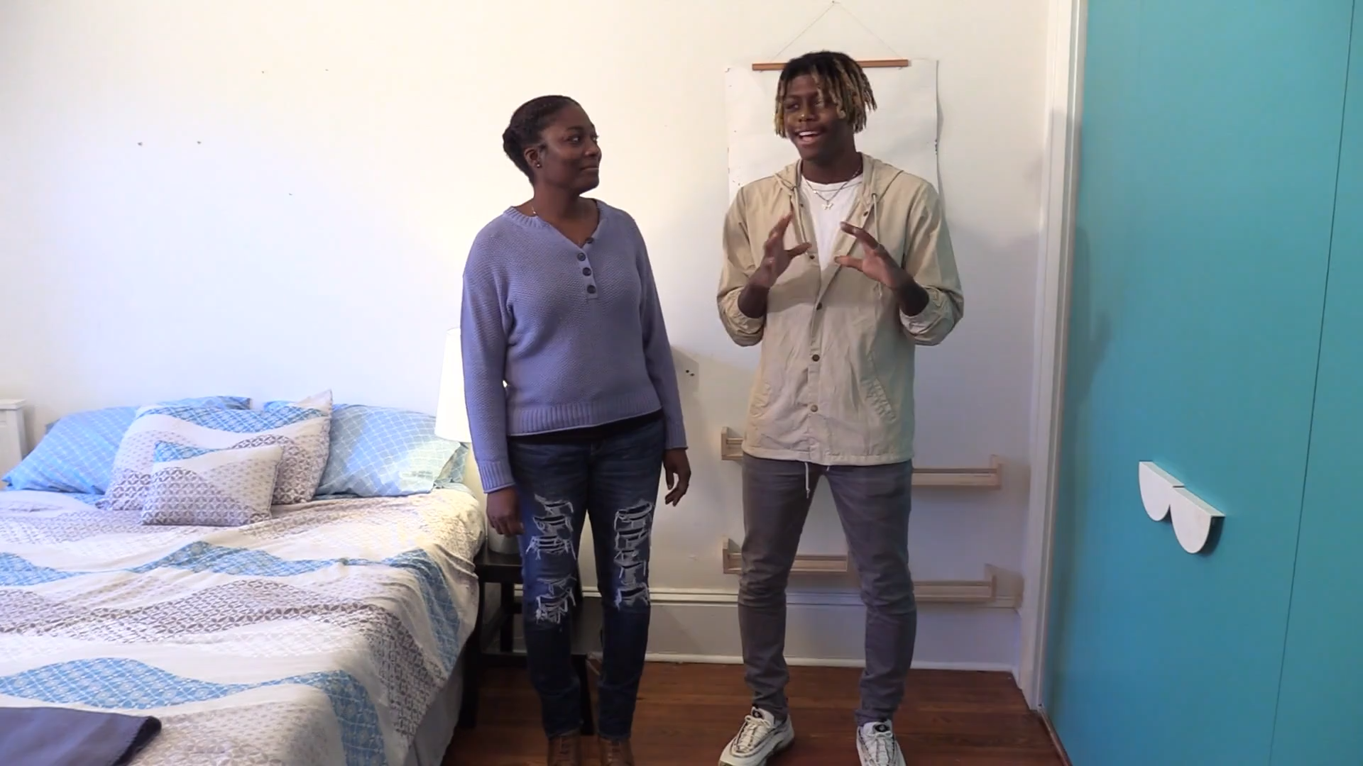
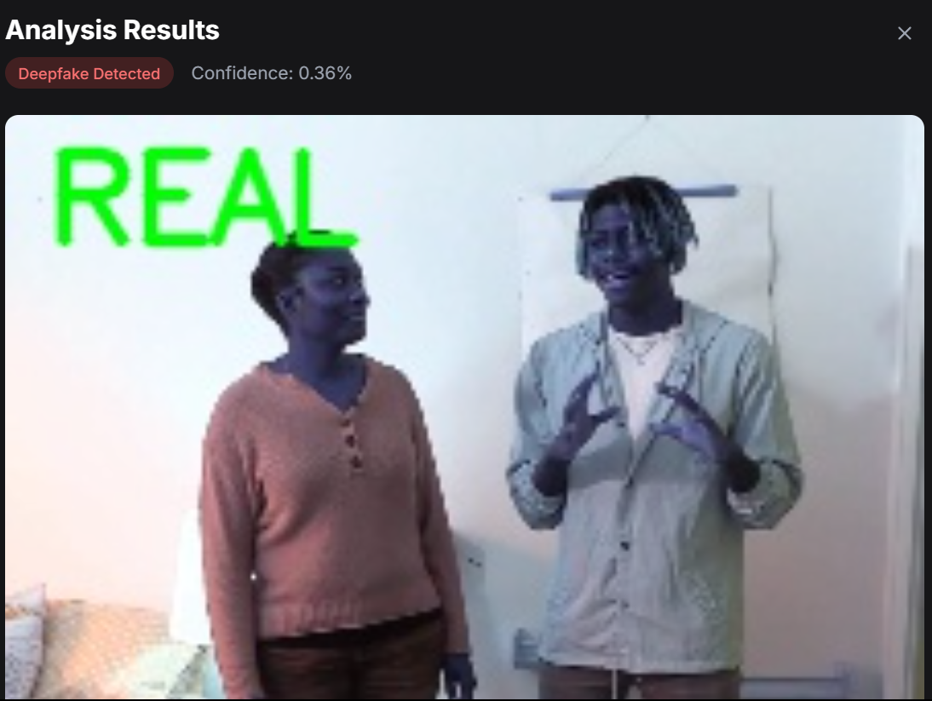

Slide 24

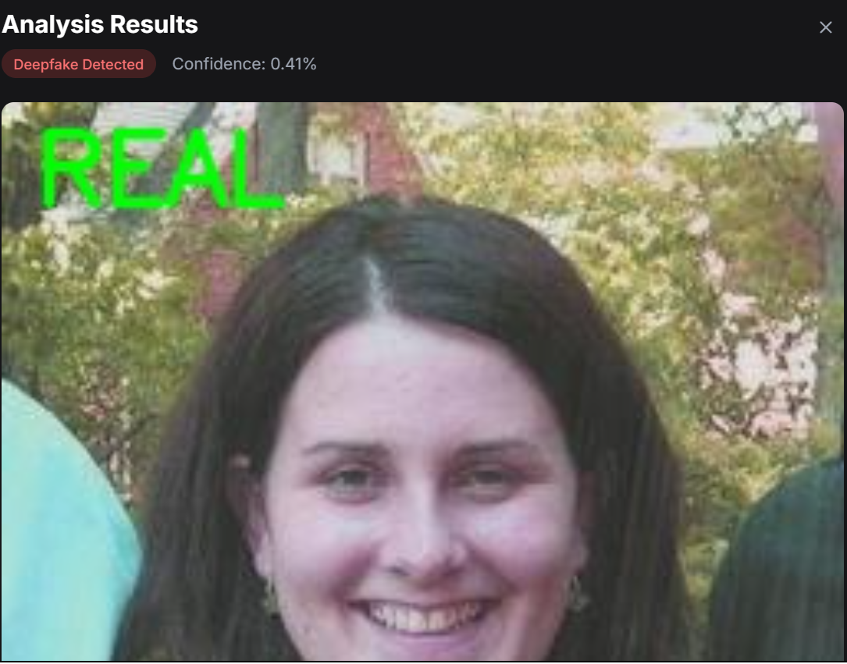

Slide 25
Result Analysis and Comparison
The performance of the deepfake detection model is analyzed based on multiple evaluation metrics, including accuracy, precision, recall, and F1-score. The results are compared across different models and datasets to assess effectiveness.
Performance Metrics
Accuracy – Measures overall correctness of the model.
Precision – Evaluates how many predicted fake images were actually fake.
Recall – Determines how well the model identifies fake images correctly.
F1-Score – Provides a balance between precision and recall.
The proposed model outperforms standard CNN-based deepfake detection methods.
It generalizes well across different datasets such as FaceForensics++, DFDC, and Celeb-DF.
Existing methods struggle with unseen deepfake generation techniques, but our approach maintains high accuracy across variations.

Slide 26
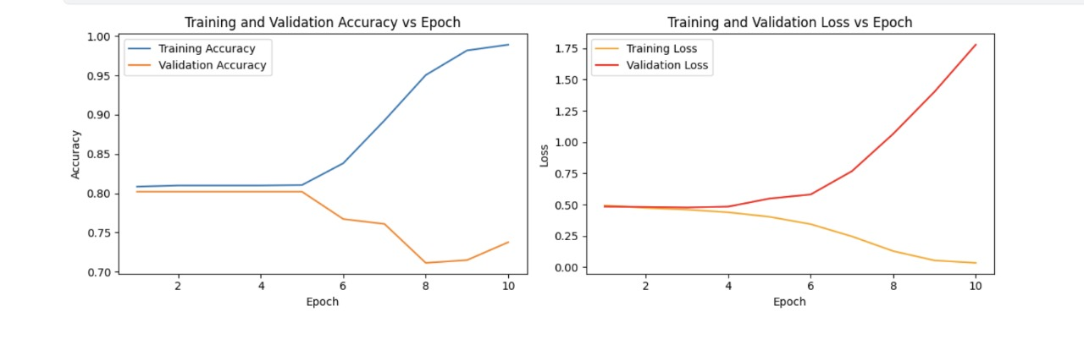

Slide 27
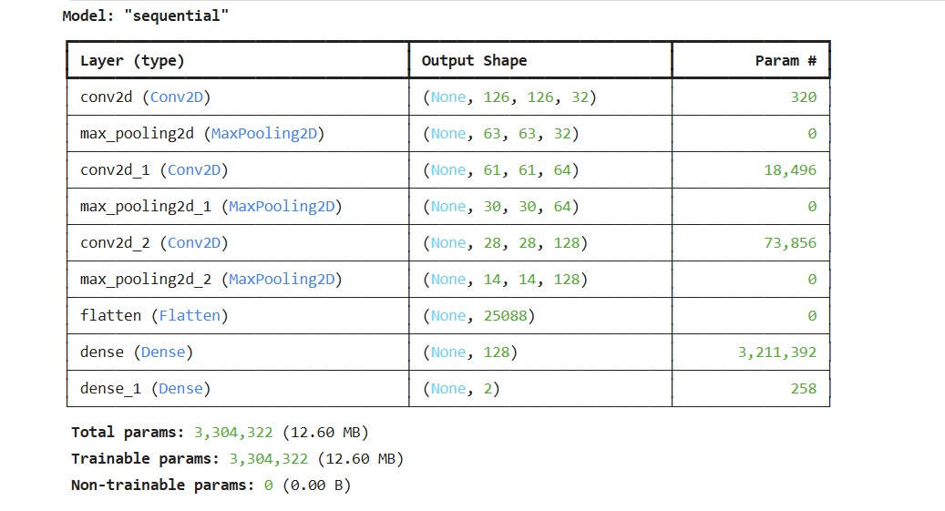

Slide 28
Demonstration
To validate the effectiveness of the deepfake detection system, real-time experiments were conducted:
Experiment 1: Real-Time Image Classification
The model correctly classified deepfake images with 80.83% GOOD accuracy.
High precision ensured minimal false positives in real-world scenarios.
Experiment 2: Video Deepfake Detection
Frames were extracted from videos and analyzed sequentially.
The CNN + LSTM model demonstrated smooth real-time inference, detecting fake content within milliseconds per frame.
Experiment 3: Cross-Dataset Evaluation
The model was tested on unseen deepfake datasets.
It successfully identified manipulated videos with an 80.83% GOOD ACCURACY, showcasing its robustness.

Slide 29
RESEARCH ARTICLE PROGRESS
ARTICLE PROGRESS: Completed
PLAGIARISM CHECK: Completed
Conference submission: Completed
Submitted to: 3rd International Conference on Networks, Multimedia, and Information Technology (NMITCON-2025)
Track name: NMITCON2025
Page name: 565

Slide 30
CONTRIBUTION
ROLL NUMBER | NAME | ROLES
21B01A5421 | CH.V.KUSUMA LATHA | MODEL DEVELOPMENT
21B01A5429 | D.MYDHILI | FRONT END DEVELOPMENT
21B01A5445 | J.PUJITHA | DATASET PREPARATION
22B05A5402 | B.ANU | ARTICLE PREPARATION

Slide 31
OpenCV, Dlib, Mediapipe
ResNext (Deep Learning Model)
LSTM (Long Short-Term Memory)
TensorFlow, PyTorch, Keras
TOOLS
IDE
Google
Jupyter Notebook
Visual Studio Code

Slide 32
Model Evaluation & Analysis: Scikit-learn (Confusion Matrix, Accuracy Metrics)
Frontend Development: React.js, HTML, CSS, JavaScript
Backend Development: Python (Flask/Django)
Deployment & Hosting: AWS, Google Cloud, Heroku, Docker (for containerization)

Slide 33
Timeline
Task | Duration
Data Collection and Preprocessing | 2 weeks
Model Development (ResNext-50 & LSTM integration) | 1 month
Training and Fine-Tuning | 1 month
Testing and Evaluation | 2 weeks
Final Deployment and Reporting | 2 weeks

Slide 34
References (in IEEE Format)
I. Goodfellow et al., "Generative Adversarial Networks," NeurIPS, 2014.
A. Rossler et al., "FaceForensics++: Learning to Detect Manipulated Facial Images," IEEE Trans. Pattern Anal. Mach. Intell., vol. 41, no. 12, pp. 2978–2991, Dec. 2019.
P. Korshunov and S. Marcel, "Deepfakes: A New Threat to Face Recognition?" J. Artif. Intell. Res., vol. 69, pp. 135–144, 2020.

Slide 35


